Slide 1
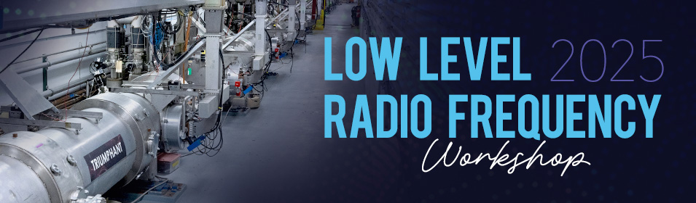
Status and Activities for LLRF at BNL C-AD and EIC
Kevin Mernick
for the BNL C-AD & EIC LLRF Groups
13 October 2025

Slide 2
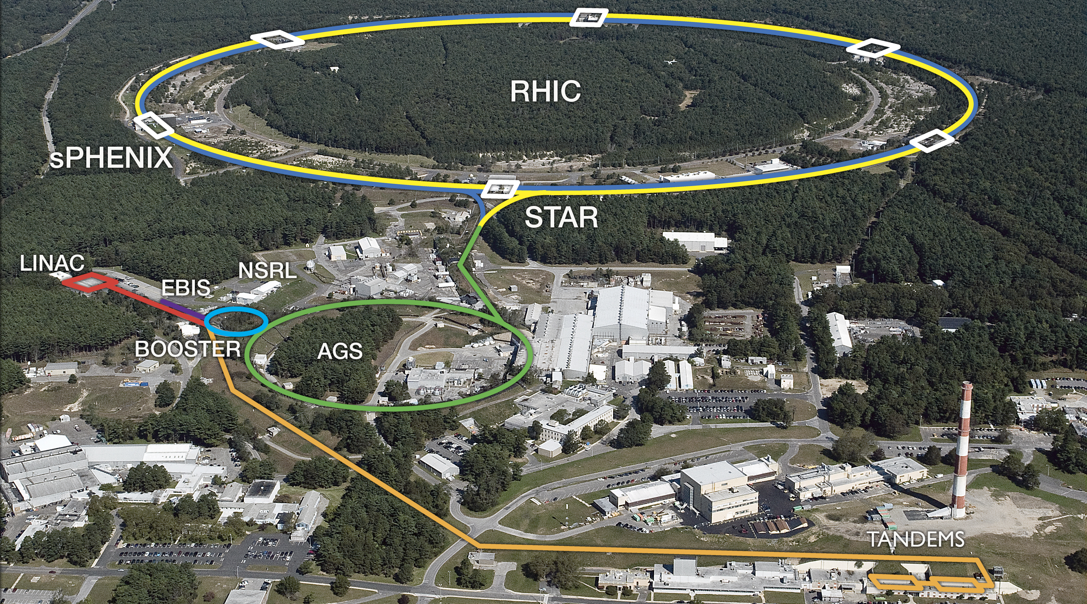
Collider-Accelerator Complex

Slide 3
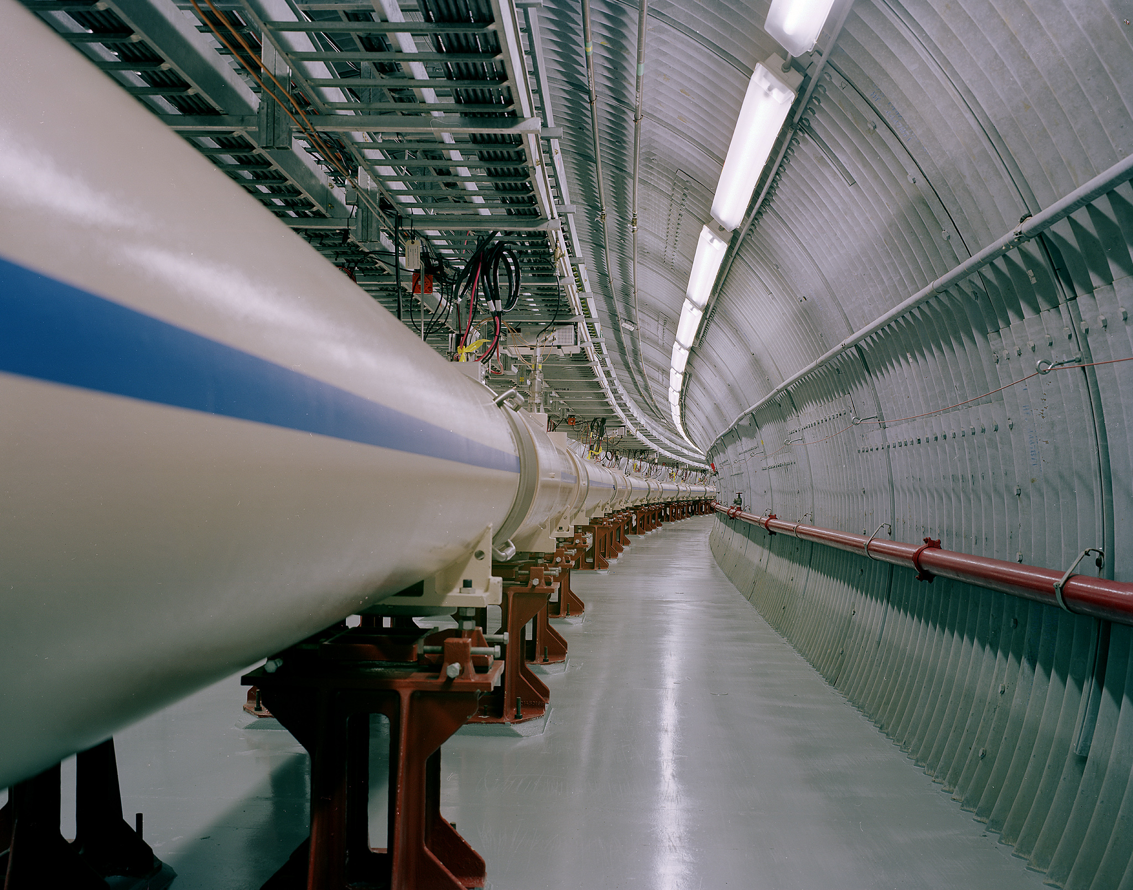
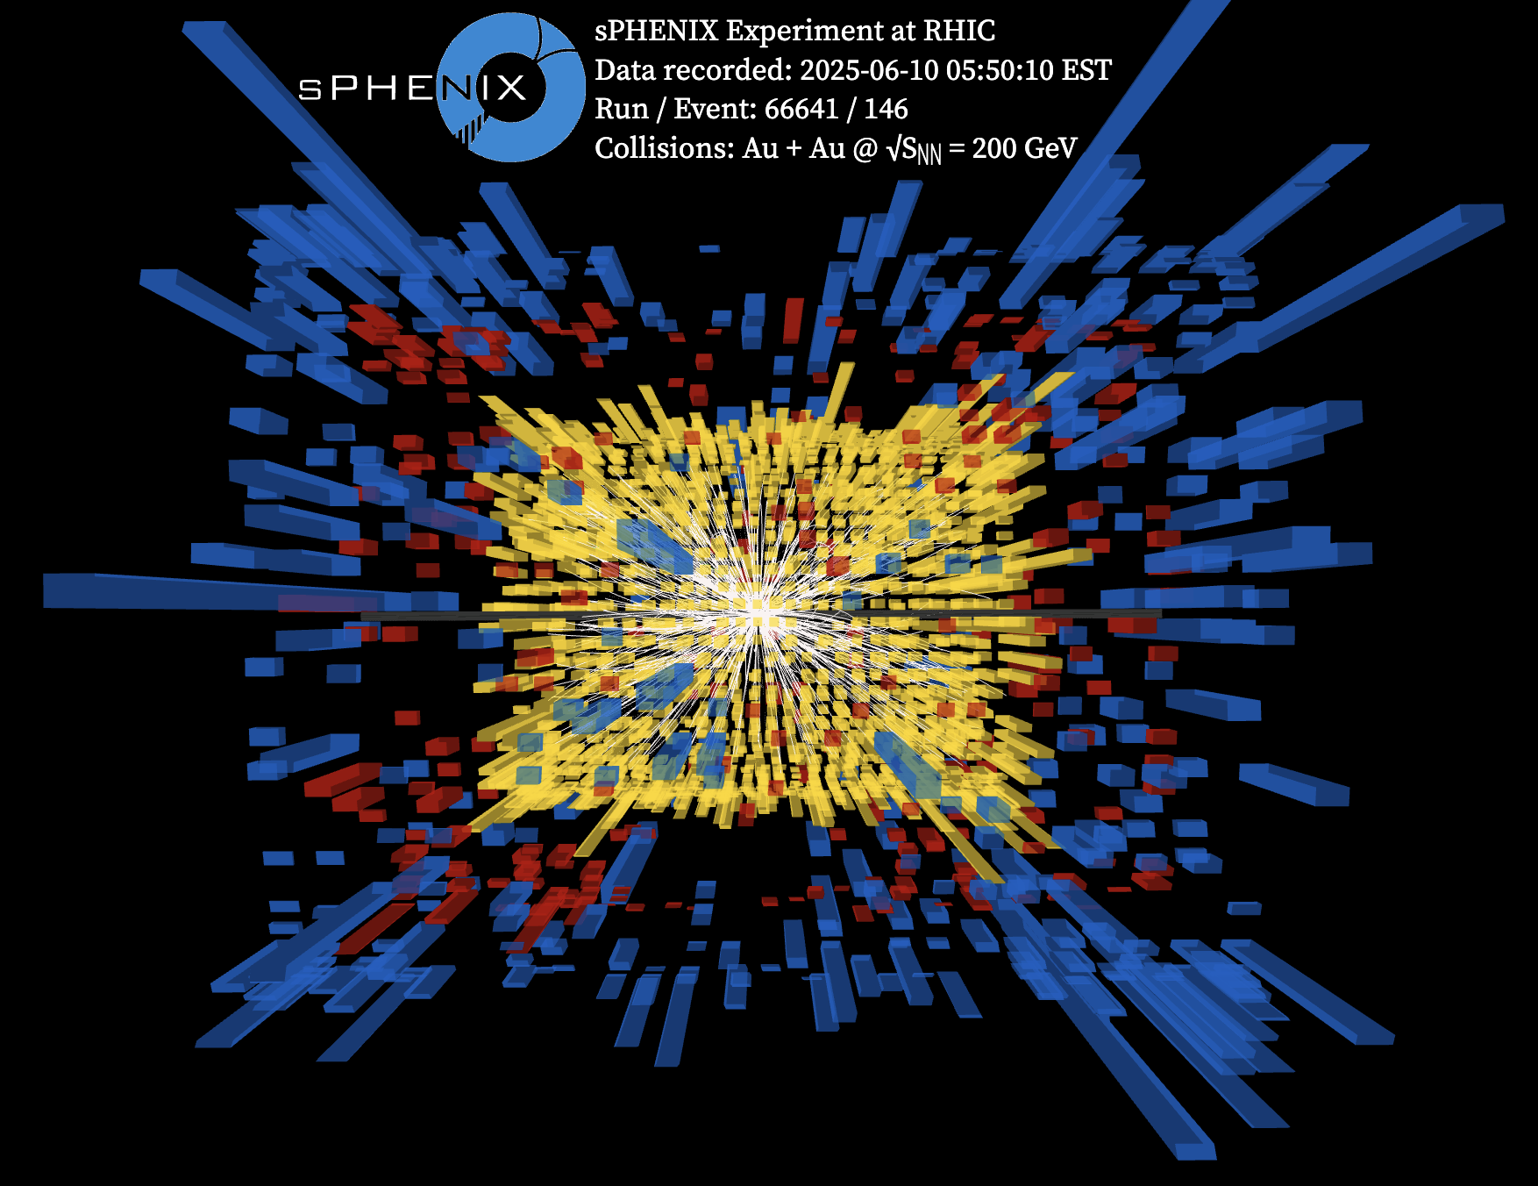
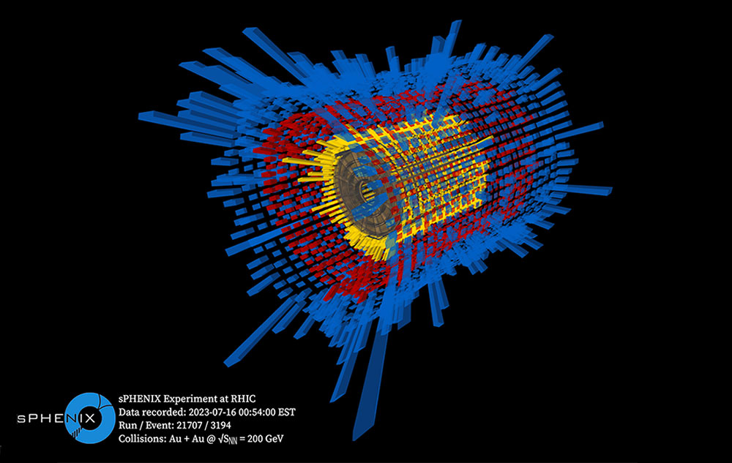
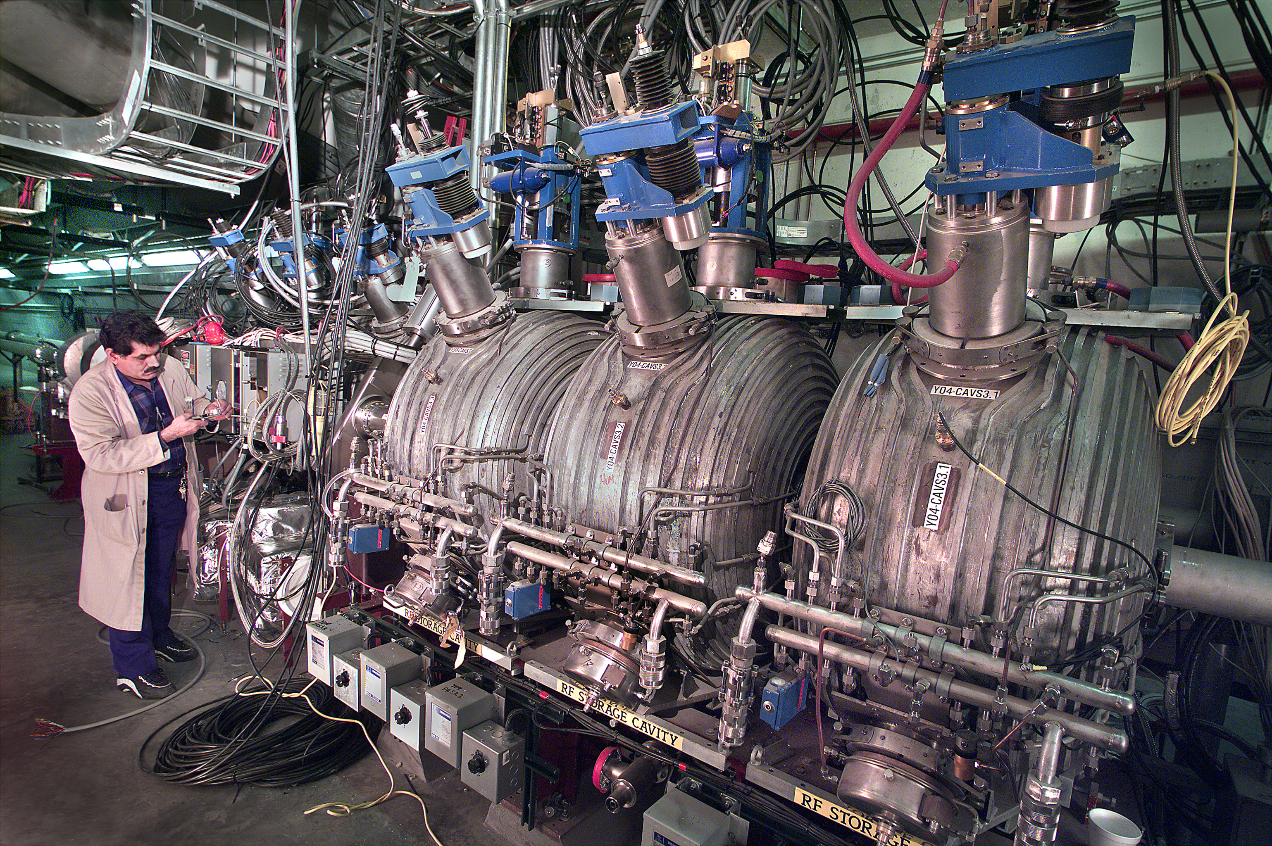
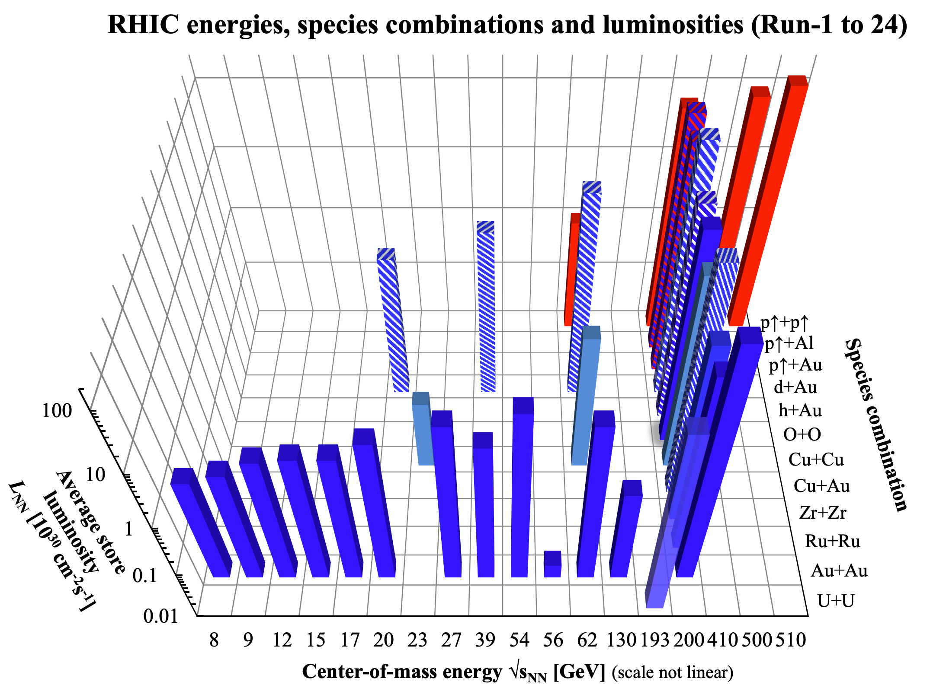
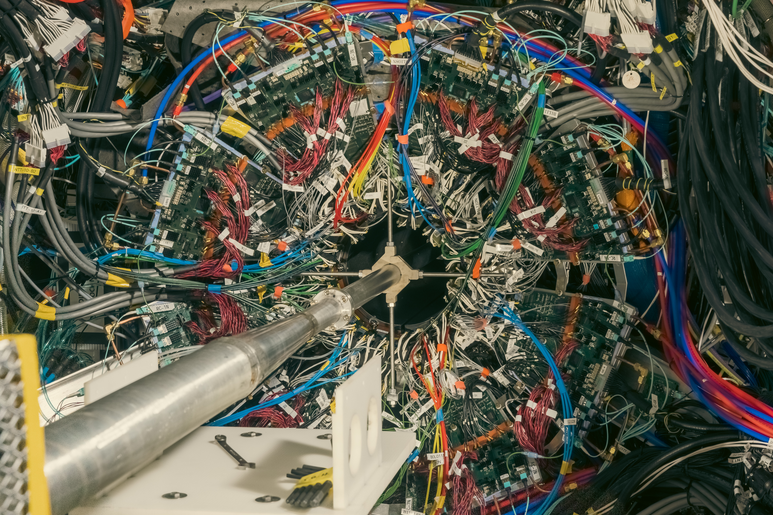
RHIC Operations
We are in the 25th and final year of RHIC operations
Since the last time we presented about RHIC (LLRF 2019)
2020 – 2021: completed Beam Energy Scan II (15 different energies, <1 day to 117 days run time for each) plus O-O and d-Au
2022: 255 GeV polarized protons
2022: complete sPHENIX installation
2023: 100 GeV Au
2024: 100 GeV polarized protons
2025: 100 GeV Au
Injector operations outside of RHIC running periods to support the NASA Space Radiation Laboratory (NSRL) and Brookhaven Linac Isotope Producer (BLIP)

Slide 4
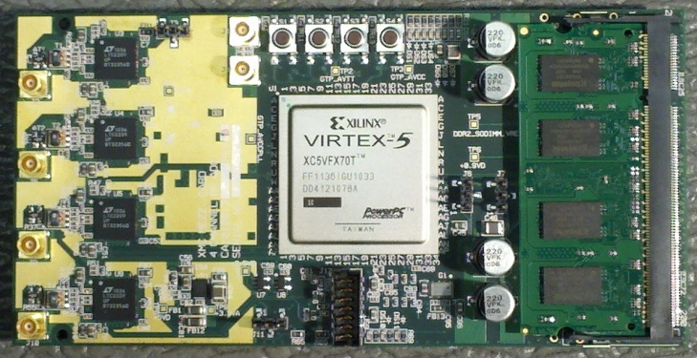
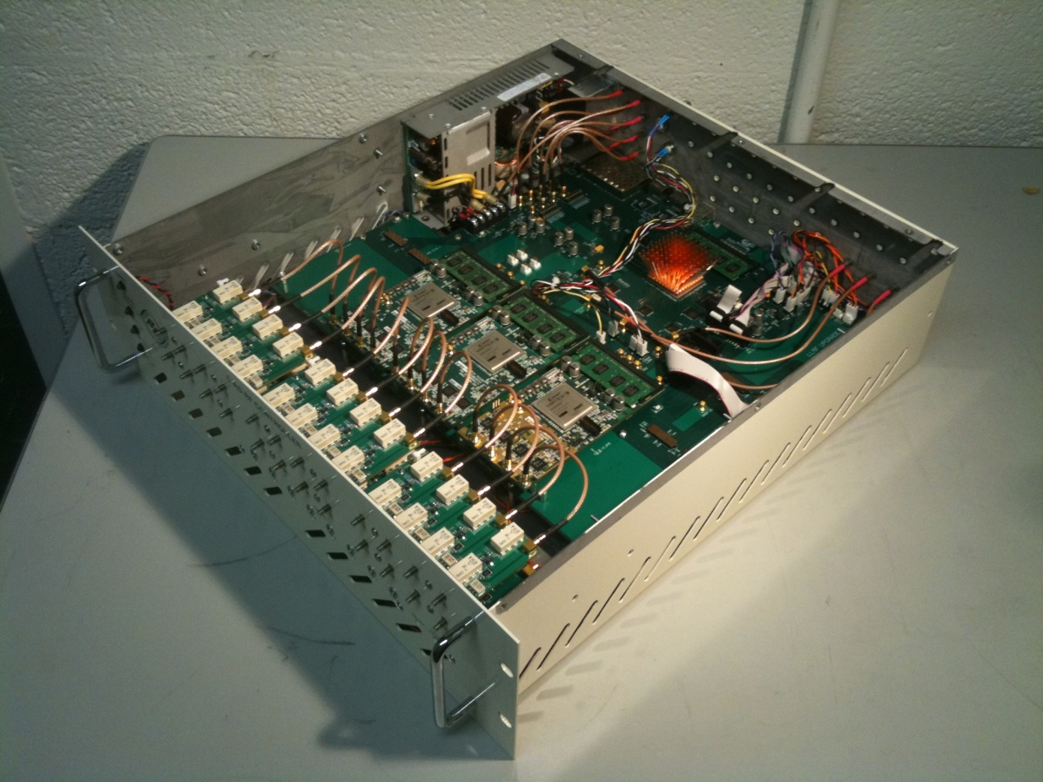
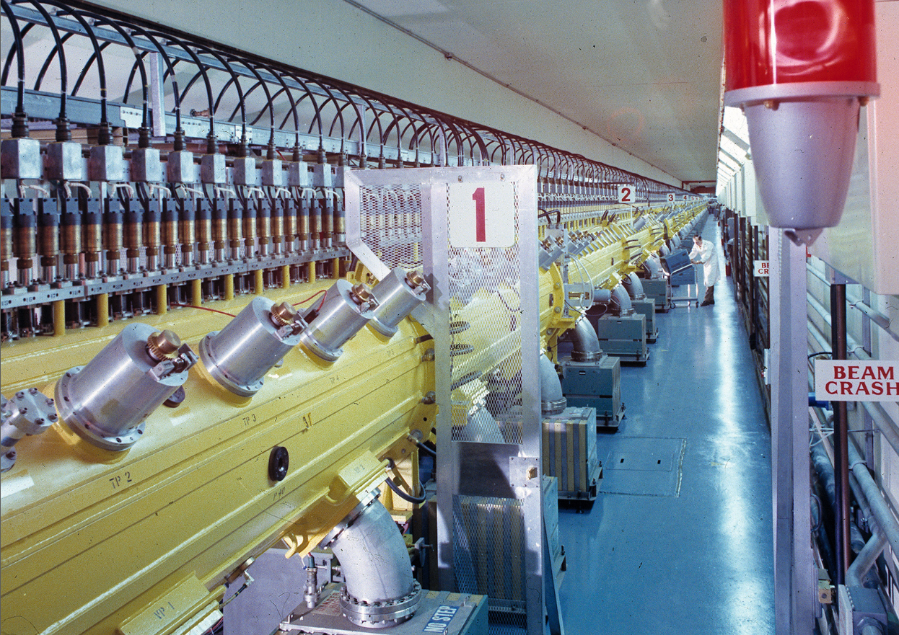
LLRF Operations
Our aging, but still capable, C-AD LLRF Platform is used in all operational accelerators and RF test facilities
Conceptual design first presented at LLRF05
Prototyping 2007-2009, first operation 2009
Roll out to all machines 2010 – 2015
Feature enhancements, new applications (electron cooling), operational efficiency, etc. 2015+
Nearly 100 chassis installed in operational systems. Retirement of RHIC systems will provide spares for the injector complex for the foreseeable future.

Slide 5
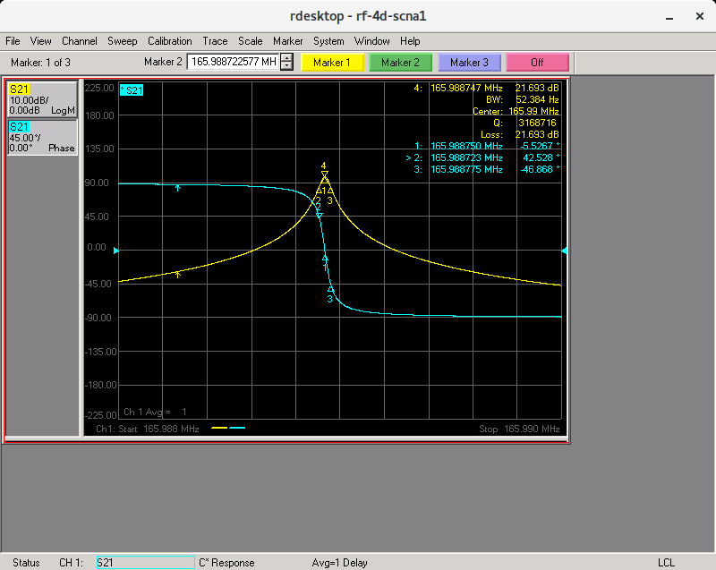
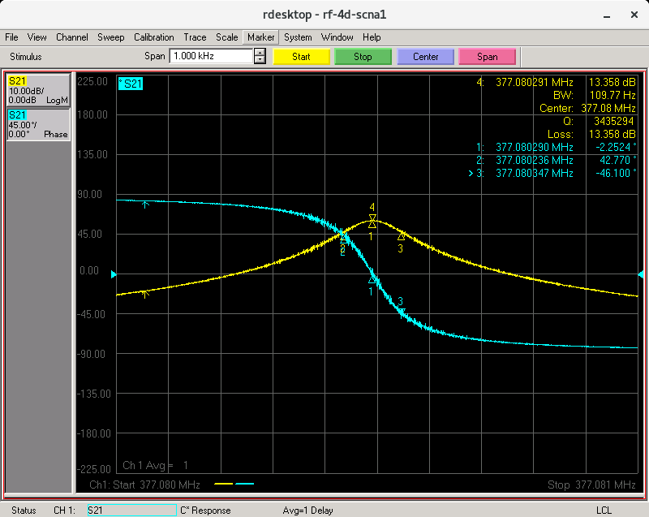
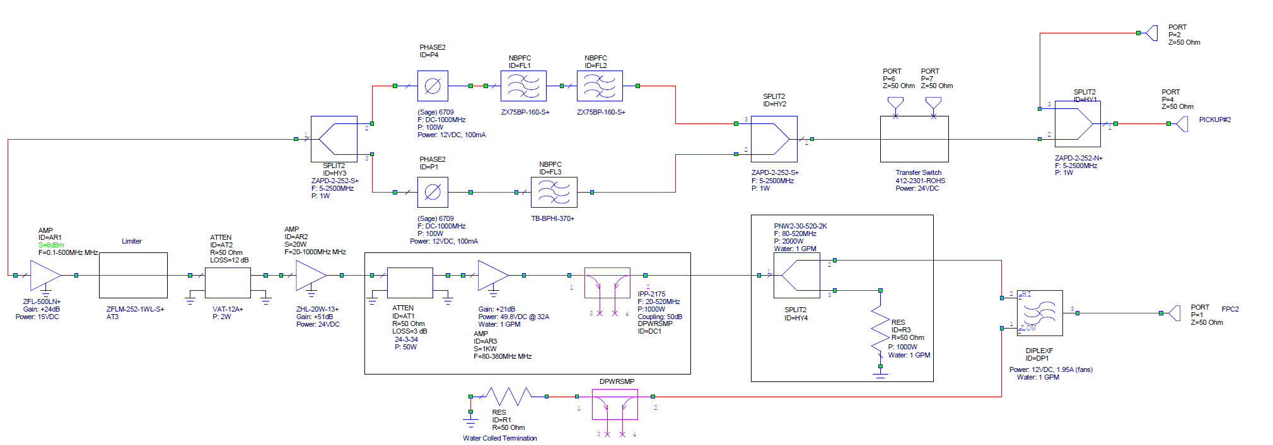
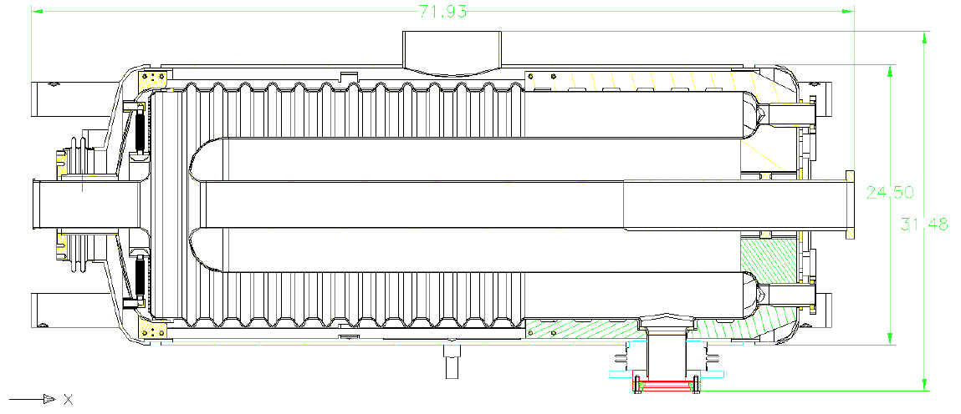
56 MHz QWR SRF HOM Active Damping
Cavity HOM dampers never worked. Combination of FMD and FPC were used to lower Q_{ext} of HOMs, at the expense of high power dissipation at the fundamental frequency.
For 2025, developed direct RF feedback to reduce impedance of 166 MHz and 377 MHz HOM modes.
Also developed ‘multi-harmonic’ processing in 4 channel ADC board to monitor 4 different HOM frequencies per RF channel.
166 MHz Open Loop
377 MHz Open Loop
8x ports
Fundamental Power Coupler(s)
Field Pickup(s)
HOM Damper(s)
beam
Accelerating Gap
Fundamental Mode Damper
M. Sowinski, M. McCooey, P. Moore, A. Singh, J. Butler, F. Severino, K. Mernick

Slide 6
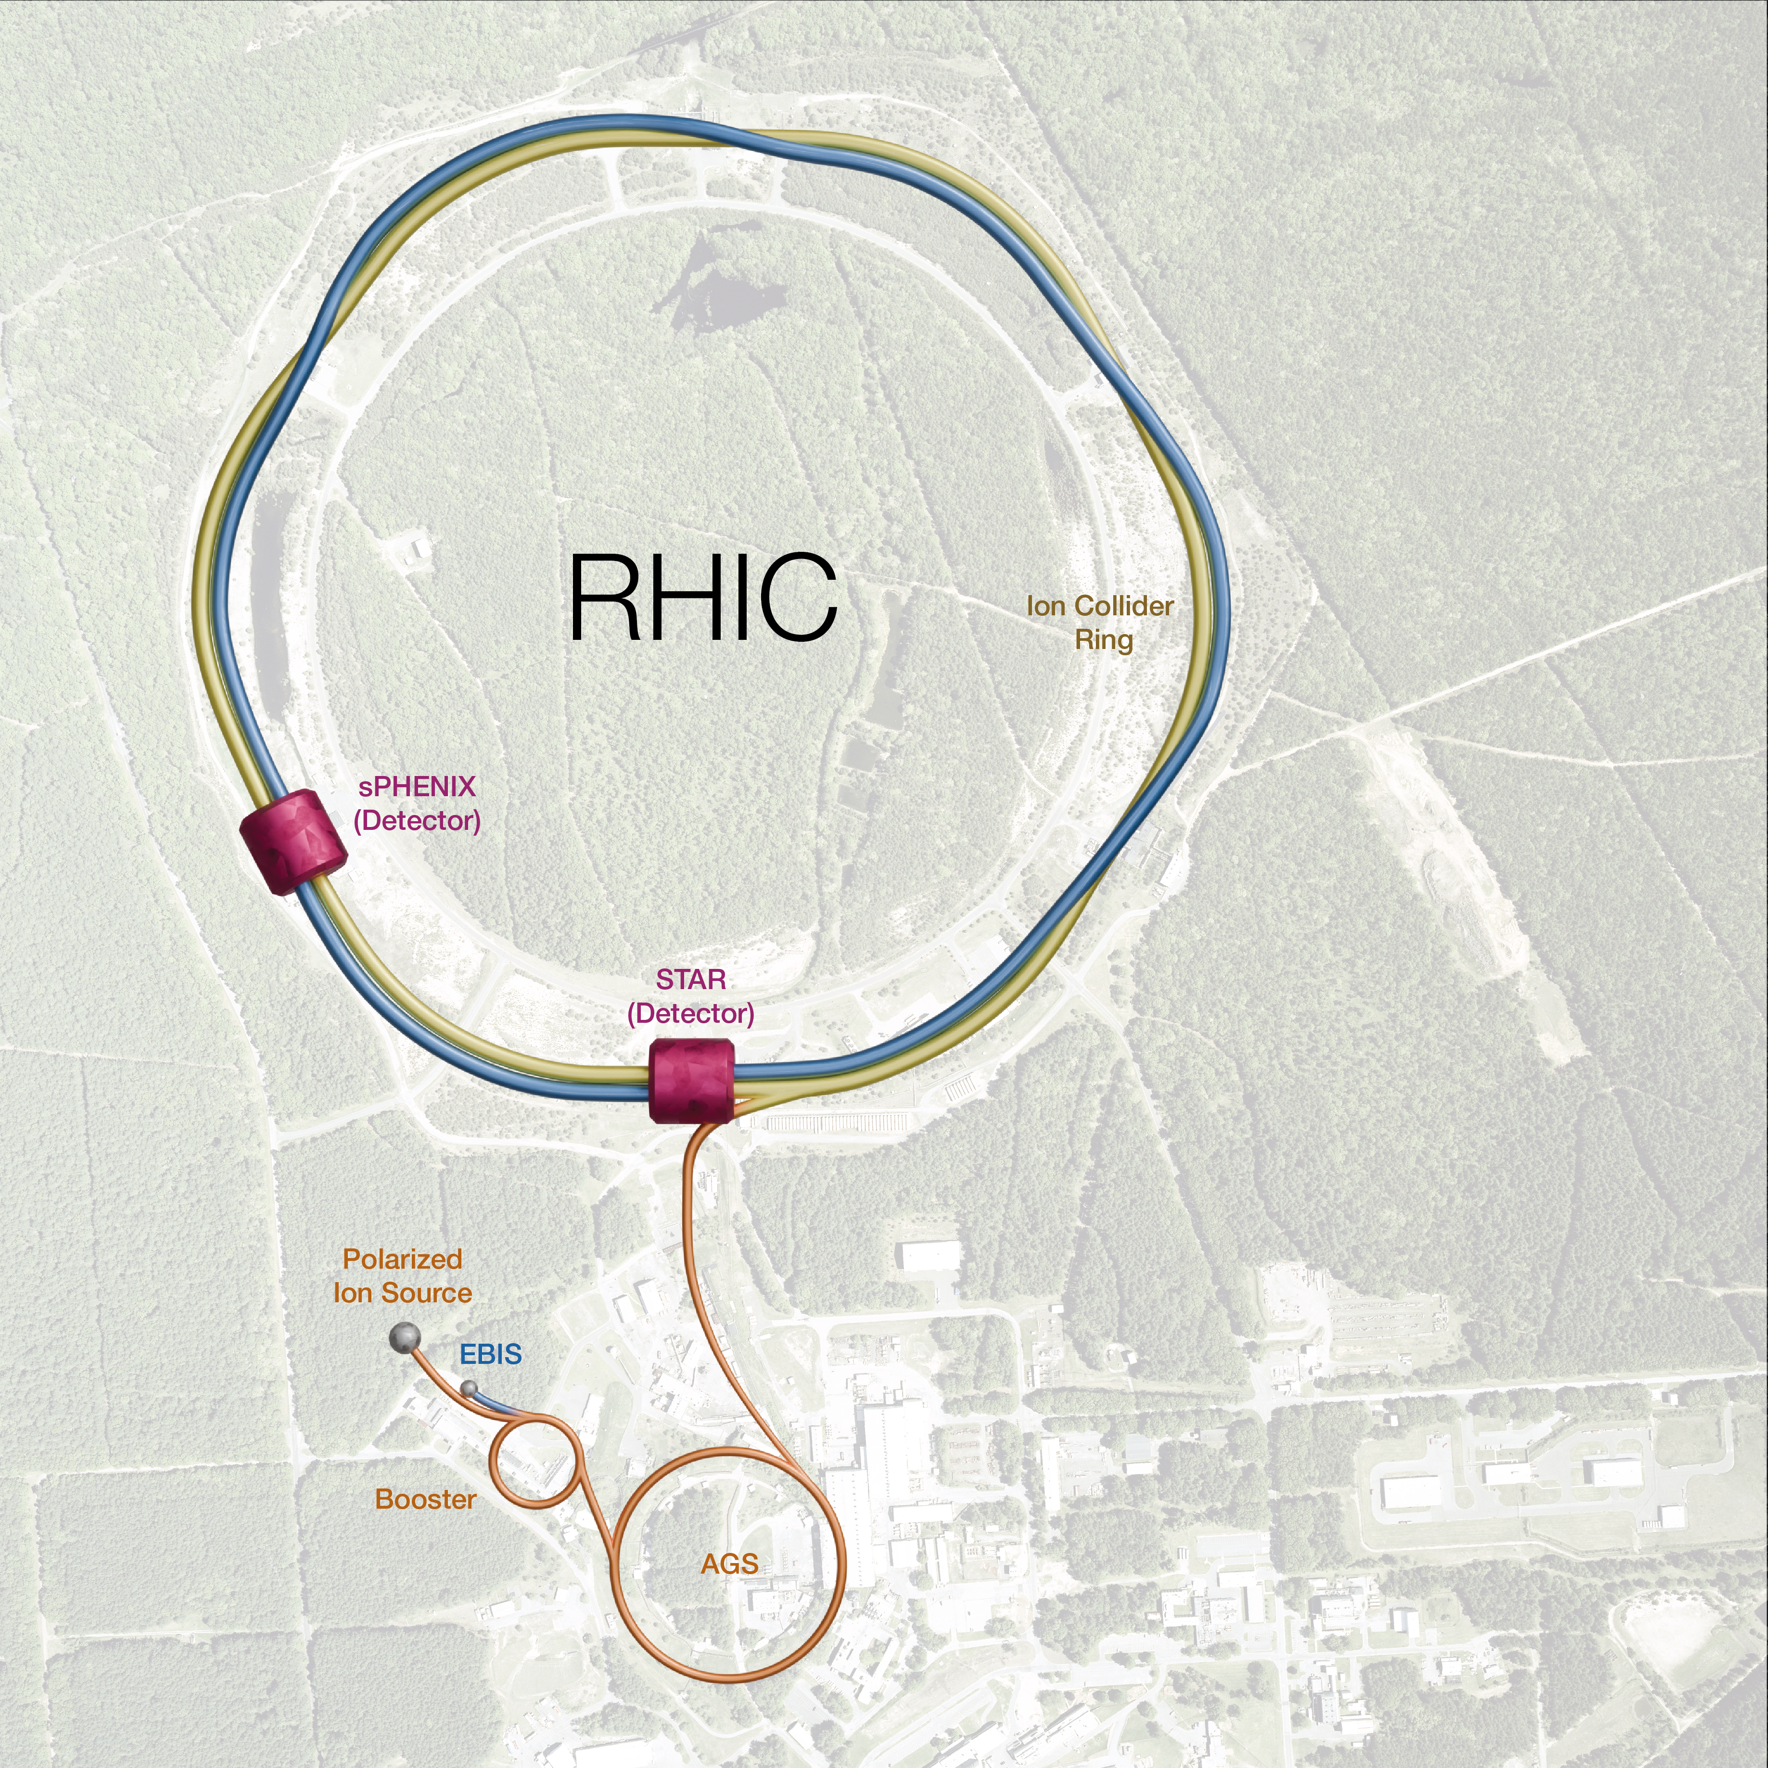
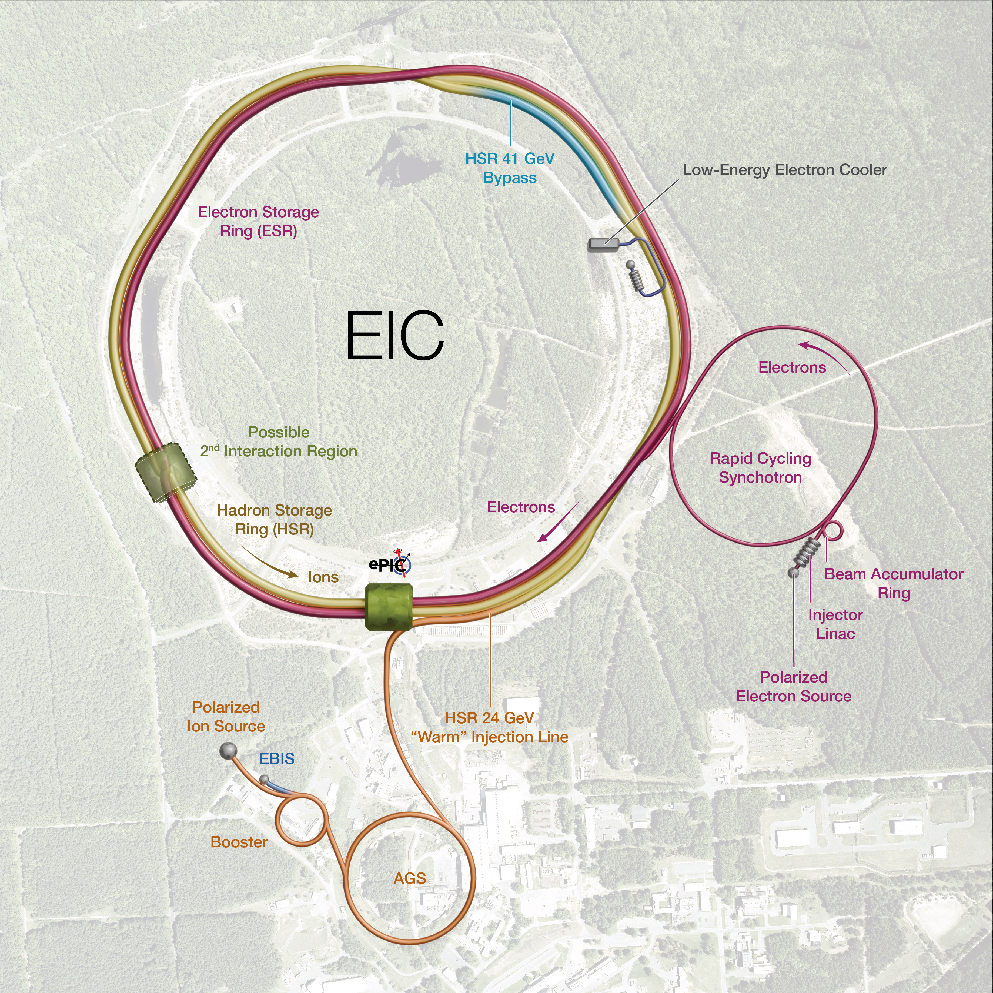
Electron Ion Collider

Slide 7
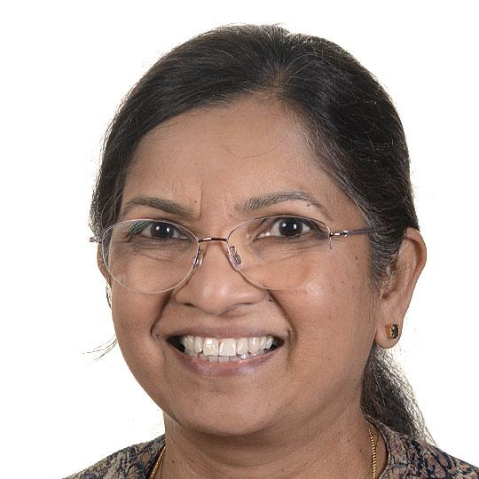
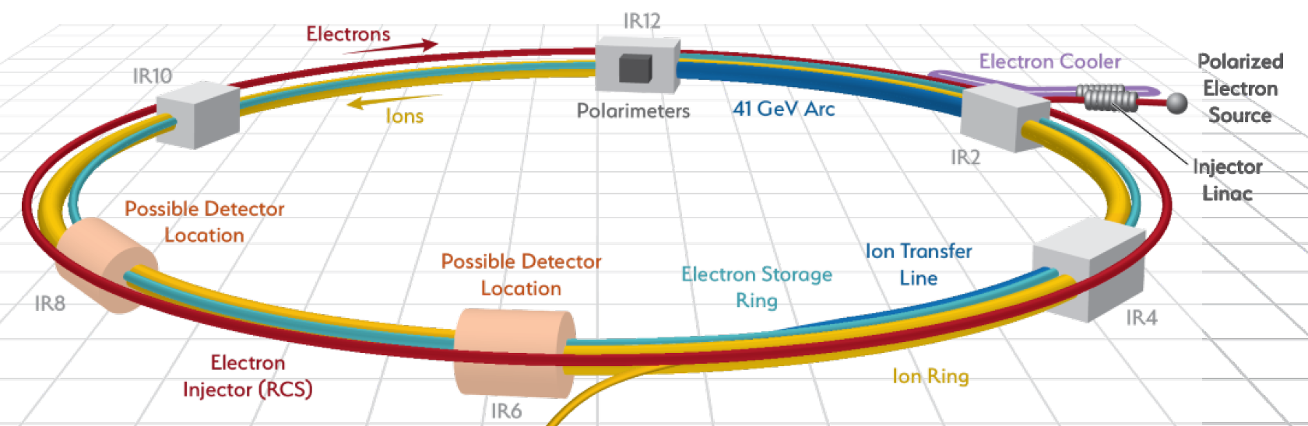
EIC Accelerator (RF) Design
Geetha Narayan, “Overview of Electron Ion Collider RF Systems,” this afternoon @ 3:15
Updates since we last presented at LLRF2022
Machine design (electron injector, hadron cooling, …)
LLRF design progress

Slide 8
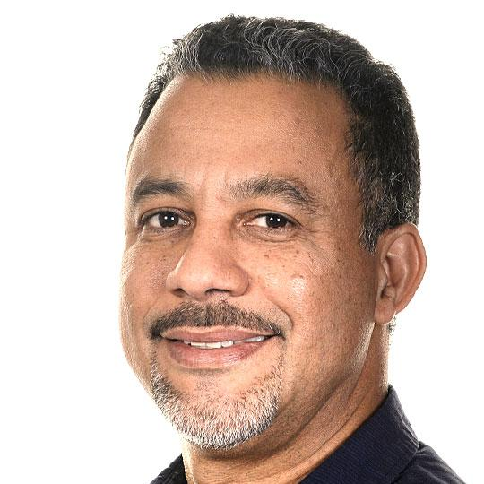

EIC Crab Cavities
Freddy Severino, “Low-Level RF System Development for EIC Crab Cavities,” Wednesday morning
LLRF system architecture and control scheme
Hardware development status and roadmap to implementation
Also
Themis Mastoridis, “Crab Cavity Low-Level RF in hadron machines,” today, after lunch
Themis has contributed enormously to our effort
Presenting about crab systems in HL-LHC and EIC

Slide 9
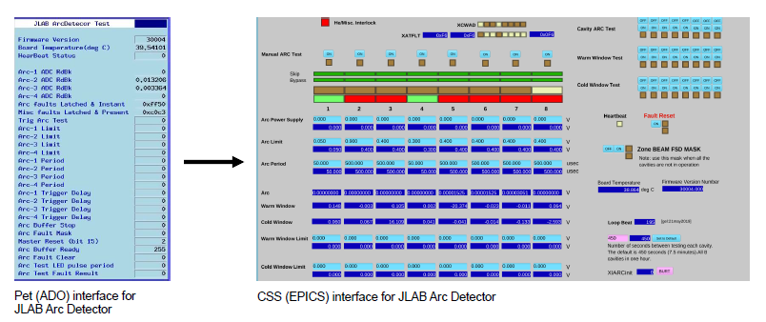
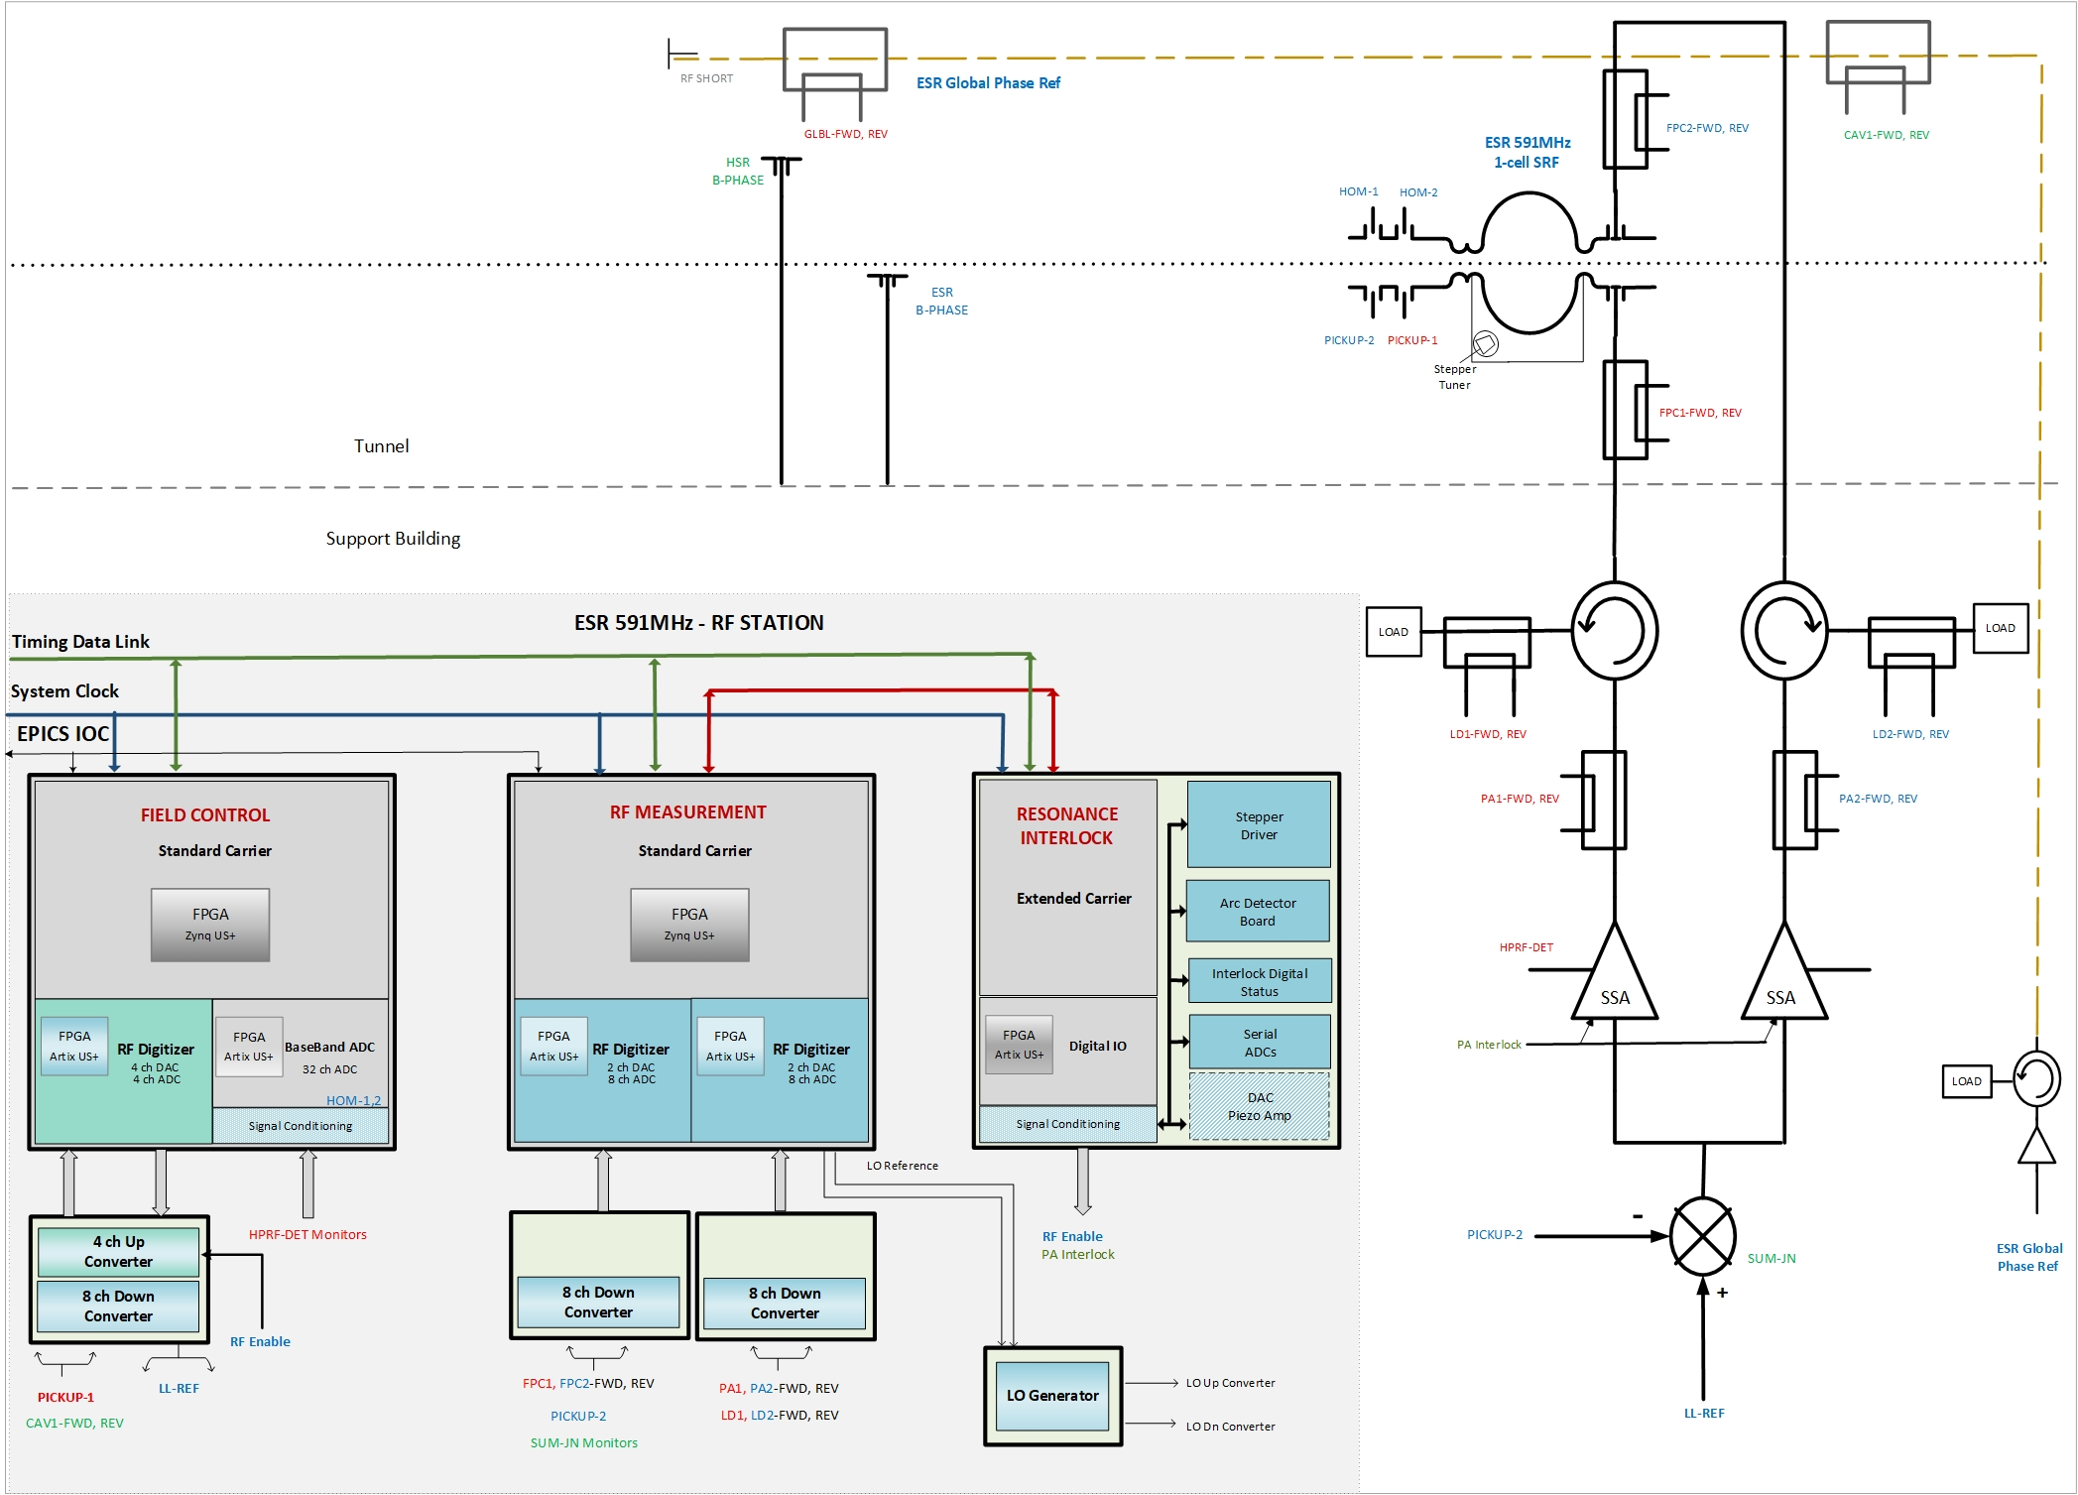
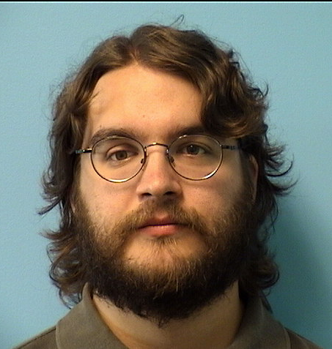
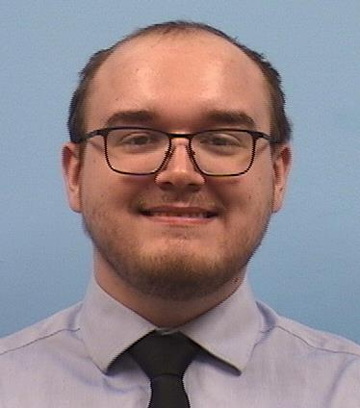
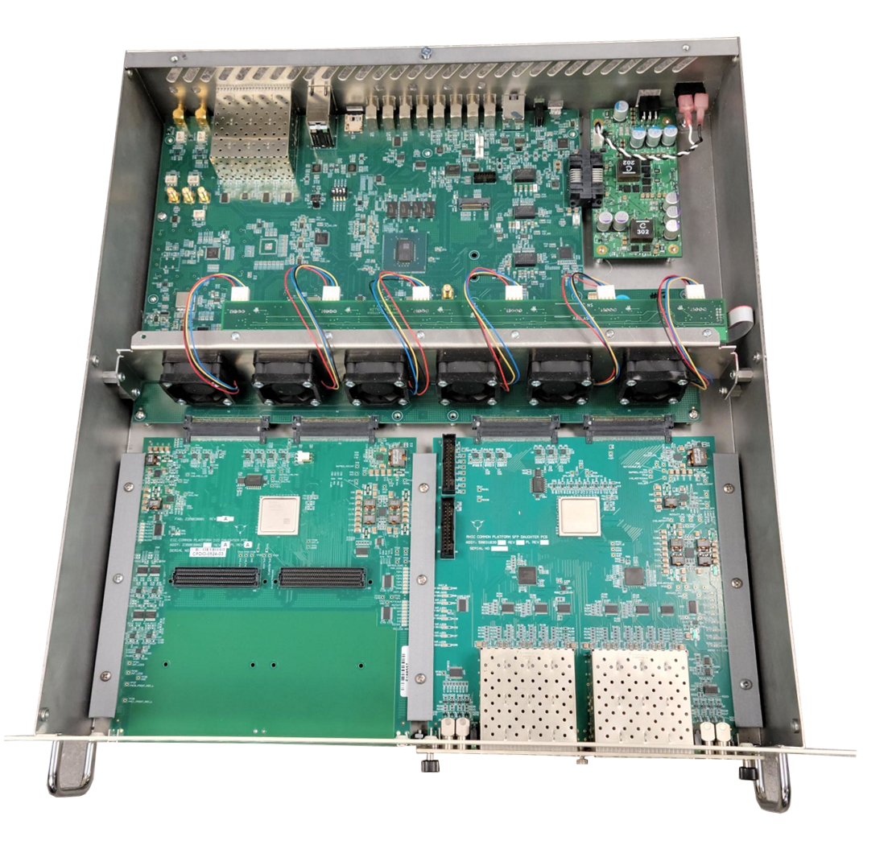
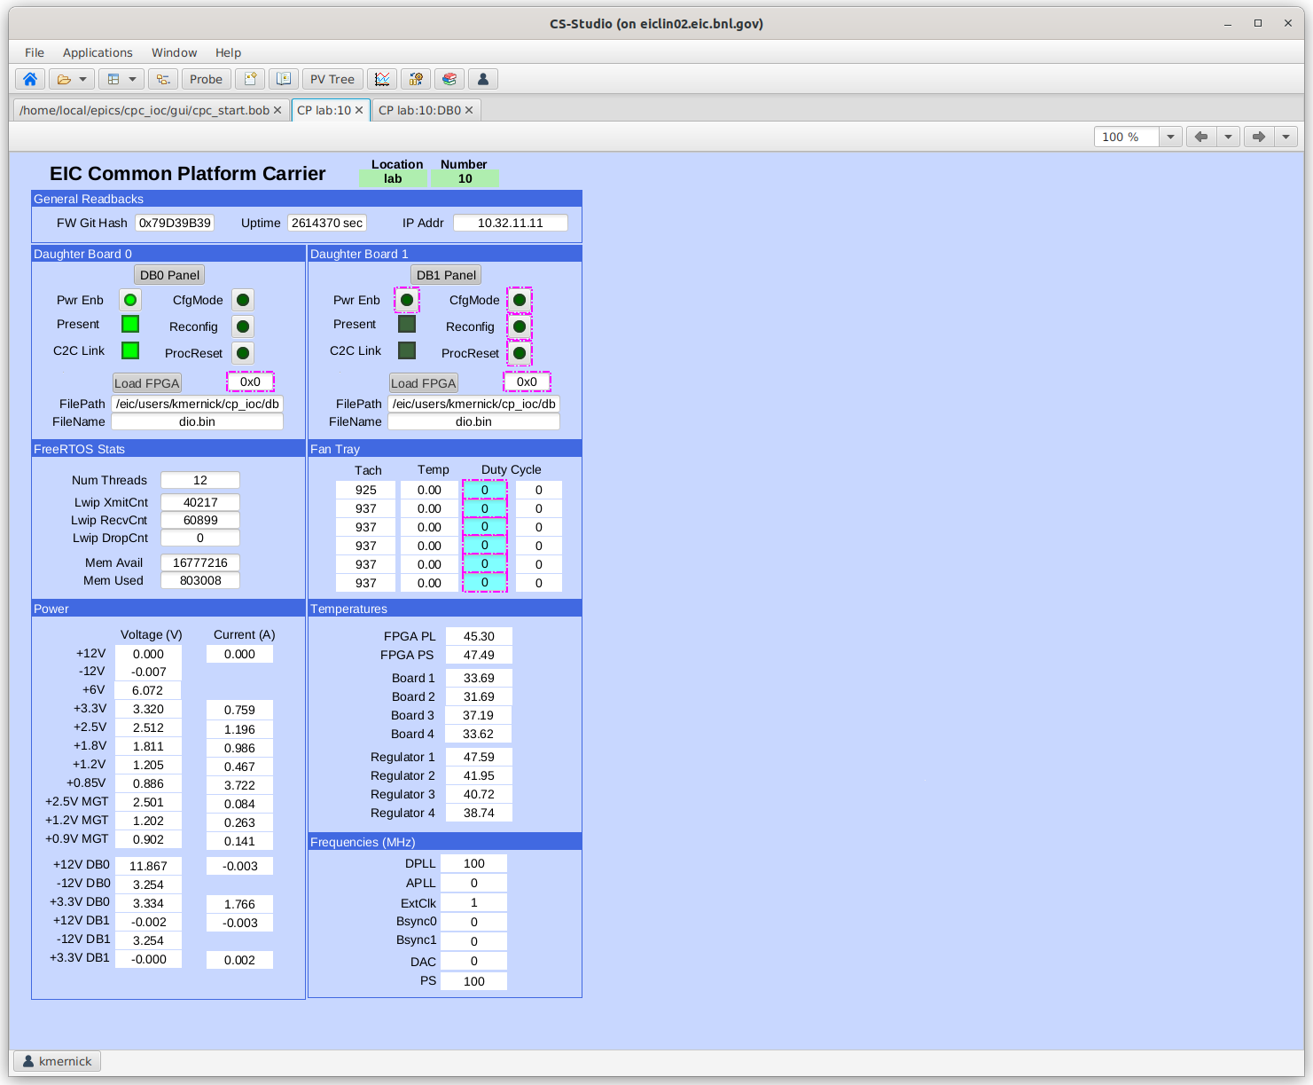
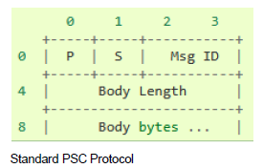

EIC LLRF Design: Controls HW/SW
Kevin Mernick, “Design of the EIC Common Platform and Applications for RF Controls,” poster, Tuesday
Kyle Fahey, “Transitioning to EPICS at EIC: PSCDrv,” poster, Wednesday
ESR 591 MHz 1-cell SRF Cavity Controller
Common Platform Carrier Chassis

Slide 10
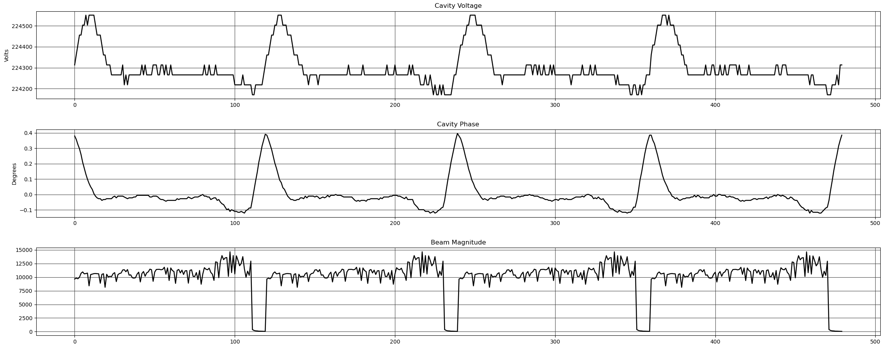
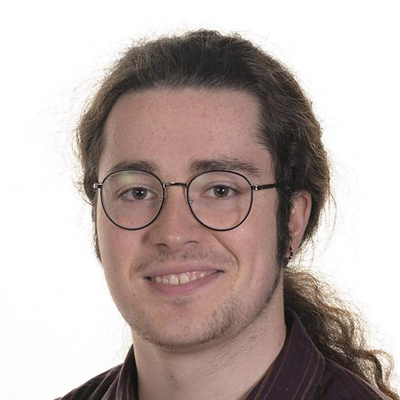

EIC LLRF Design: Cavity Control
Michael McCooey, “The Development of an Ultra-Low Phase Noise Source for EIC Crab Cavities,” poster, Tuesday
Arshdeep Singh, “LLRF Upgrades for Studying Transient Beam-Loading in RHIC 28 MHz Accelerator Cavity for the EIC,” poster, Wednesday
Periodic Transient Beam Loading from Beam Abort Gap
Developmental Clock Receiver Chassis
OTFB Transfer Function Measurement
FFWD Transient Compensation

Slide 11
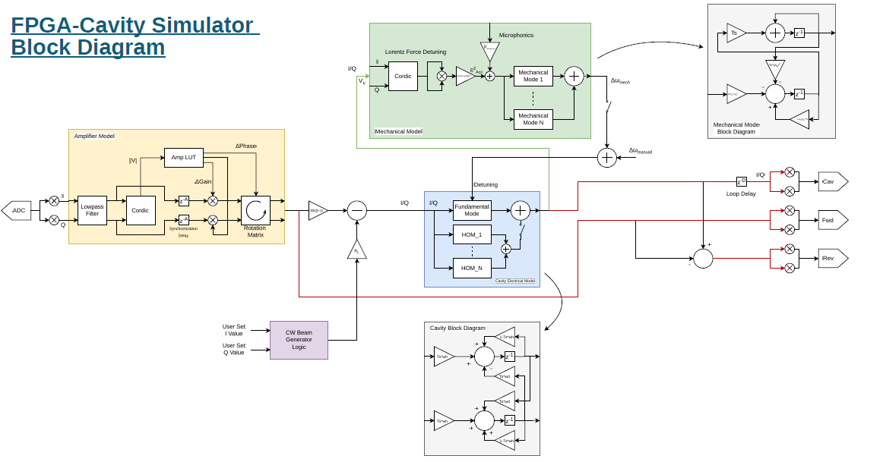
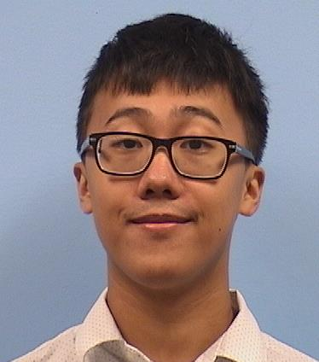
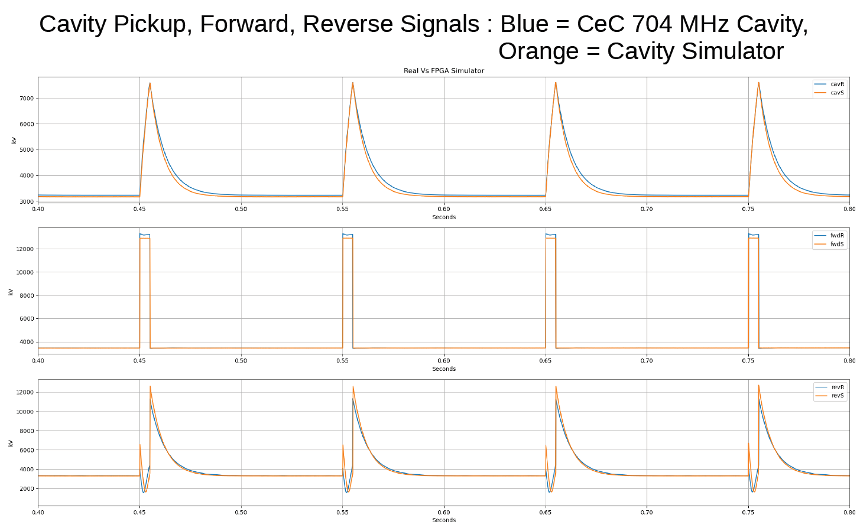
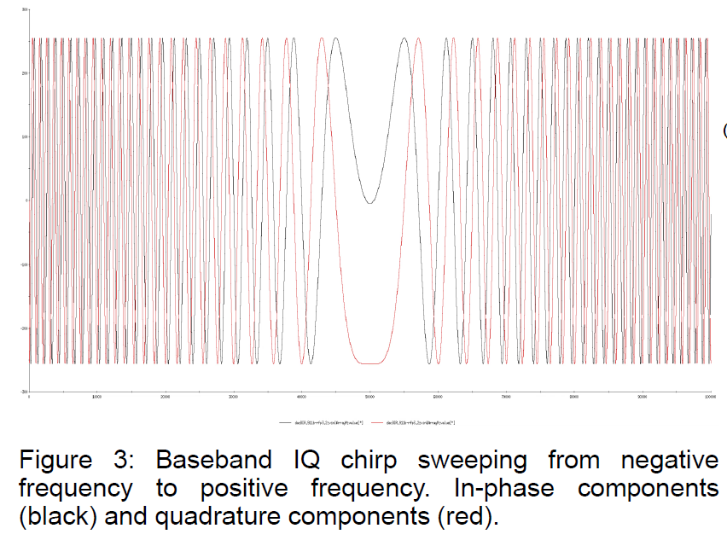
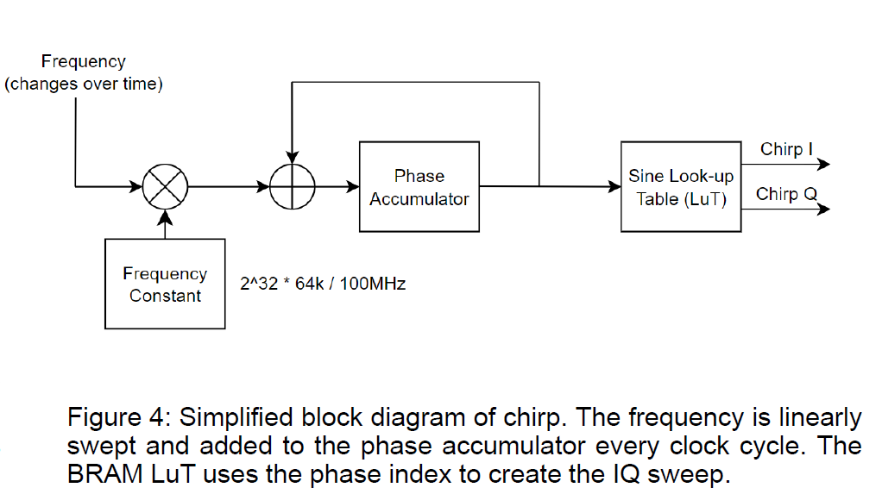
EIC LLRF Tools for Design & Test
Arshdeep Singh, “Development of an FPGA-based Cavity Simulator for Testing RF Controls,” poster, Wednesday
Samson Mai, “Baseband Digital Network Analyzer Upgrade for LLRF Controllers,” poster, Wednesday
RHIC 28 MHz Cavity Direct RF Feedback Response

Slide 12
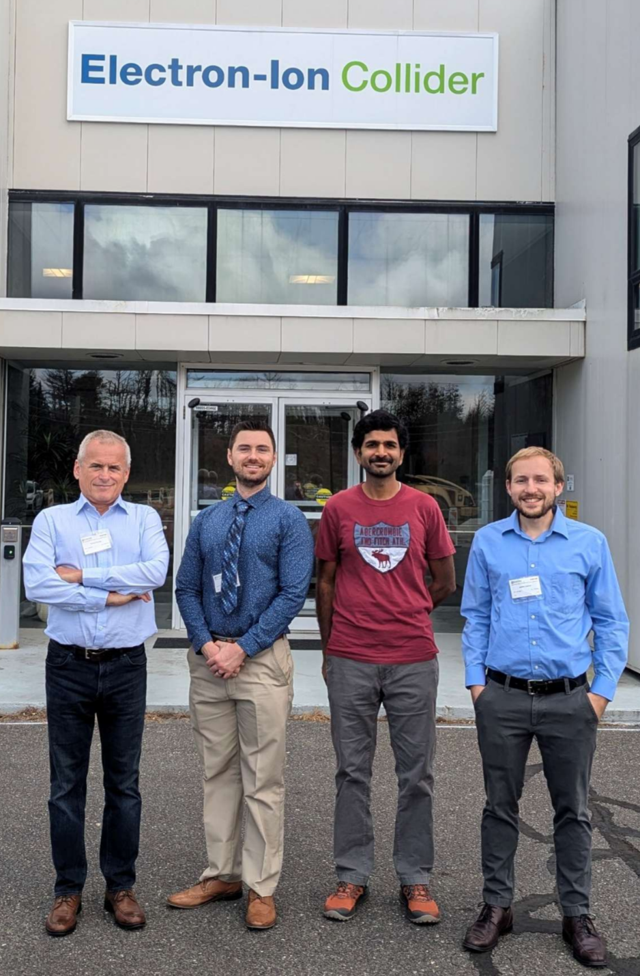
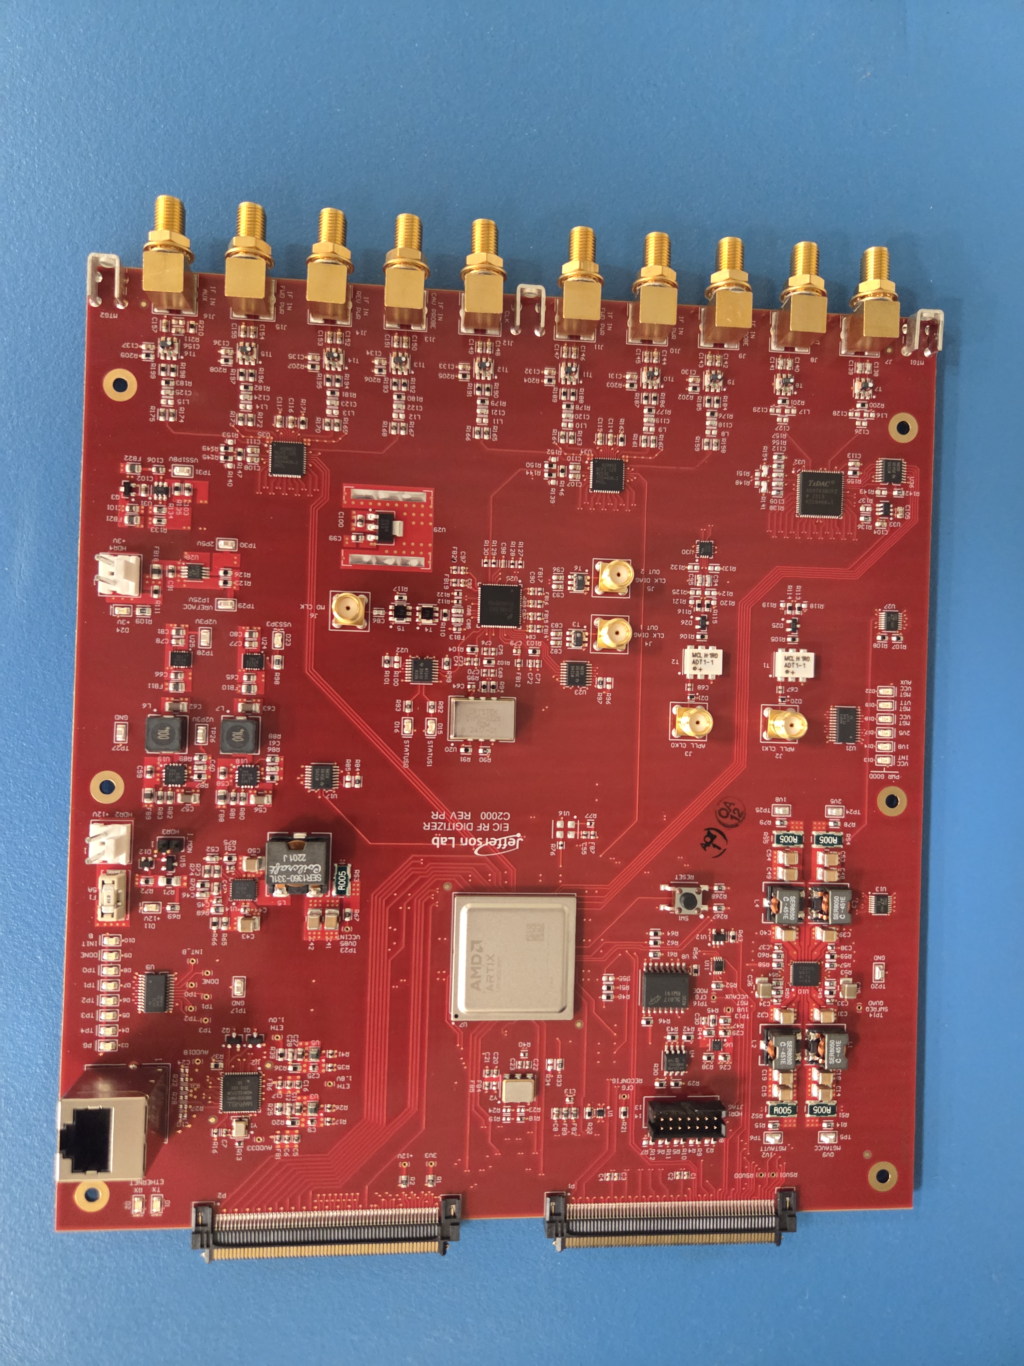
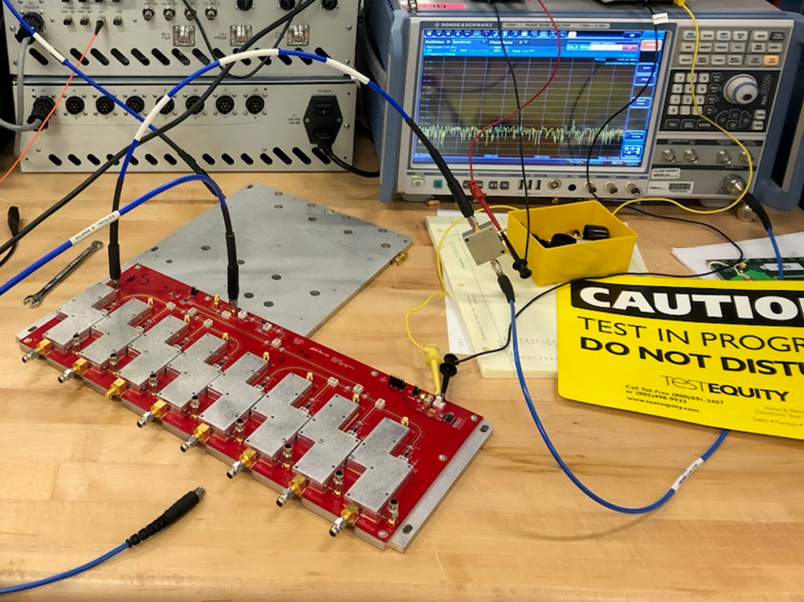

EIC LLRF Collaboration Team
Our JLab colleagues are an integral part of the EIC LLRF team – even though this is the BNL Lab talk, I couldn’t leave them out.
J. Latshaw, “EIC Resonance and Interlocks Control”
J. Settle, “Local Oscillator Conditioner for the EIC”
R. Bachimanchi, no EIC poster, but the digitizer board he designed was delivered last week
From Left: Tomasz Plawski, Joshua Settle, Rama Bachimanchi, James Latshaw

Slide 13
Summary and Outlook
This has been a period of transition for our team and Brookhaven
Last RHIC run is bittersweet, but EIC is an exciting future
Lots of new faces in our group for both low-level and high-power systems
Glad that our new LLRF engineers could attend and meet others in the community
Familiar faces in new (or additional) roles:
Kevin Smith – EIC Deputy Technical Director
Alex Zaltsman – former C-AD & EIC RF Group Leader, now in senior advisor role
Freddy Severino – C-AD Department RF Group Leader
Silvia Verdu Andres – EIC Department RF Group Leader
Geetha Narayan – EIC RF Controls L3 manager
Tom Hayes & Kayla Hernandez moved on to other departments at BNL

